Slide 1
KeyStone II Interrupts
xx

Slide 2
Agenda
Motivation for this presentation
The interrupt Scheme
Configure interrupt

Slide 3

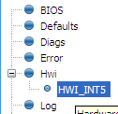
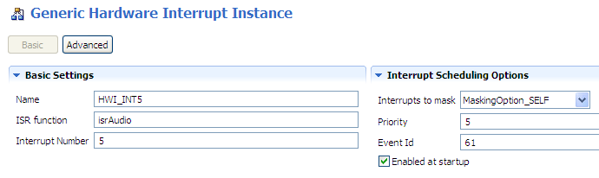
Configuring an Hwi: Statically via GUI
Example:
Tie SPI_INT to the CPU HWI₅
1
Use Hwi module (Available Products), insert new Hwi (Outline View)
NOTE: BIOS objects can be created via the GUI, script code, or C code (dynamic).
2
Configure Hwi: Event ID, CPU Int #, ISR vector:
To enable INT at startup, check the box
Where do you find the Event Id #?

Slide 4

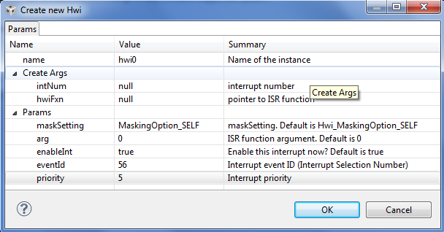
Hardware Event IDs
How do you know the names of the interrupt events and their corresponding event numbers?
Look it up in the datasheet.
Source: TMS320C6678 datasheet
As appropriate, refer to the datasheet for your target platform.
What happens in the ISR ?

Slide 5
Agenda
Motivation for this presentation
The interrupt Scheme
Configure interrupt

Slide 6
System Events

Slide 7
System Events Some events are connected directly to Cores But not event 56

Slide 8
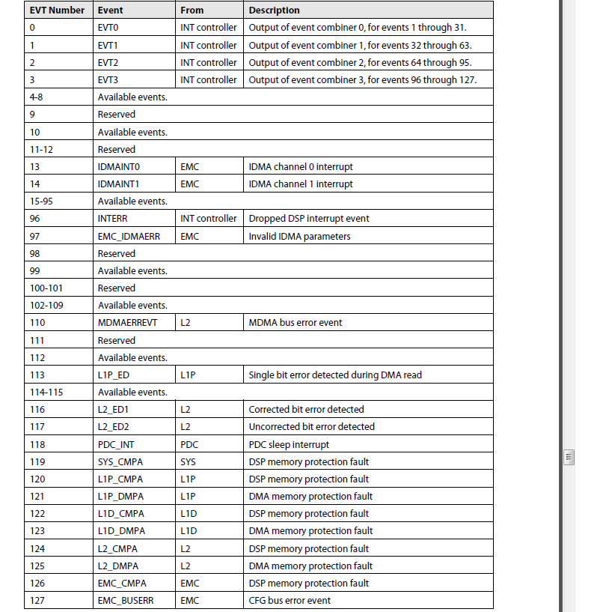
C66 Event Mapping
Table 9-2 in the C66 UG
22 assigned events (5 reserve primary events, 17 secondary events)
7 reserved events
99 Available events
The available events are connected to the Device. The next slides will show how and what is connected to the available events in the 6638 device.

Slide 9
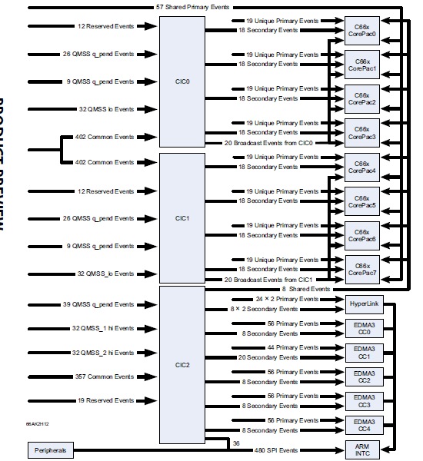
C6638 Interrupt Topology
Table 5-4 in the 66AK2H12
All events from all IP come to the interrupt controllers
Some are connected directly to C66 or other masters (EDMA, ARM, Hyperlink) and some are mapped by the interrupt controllers

Slide 10
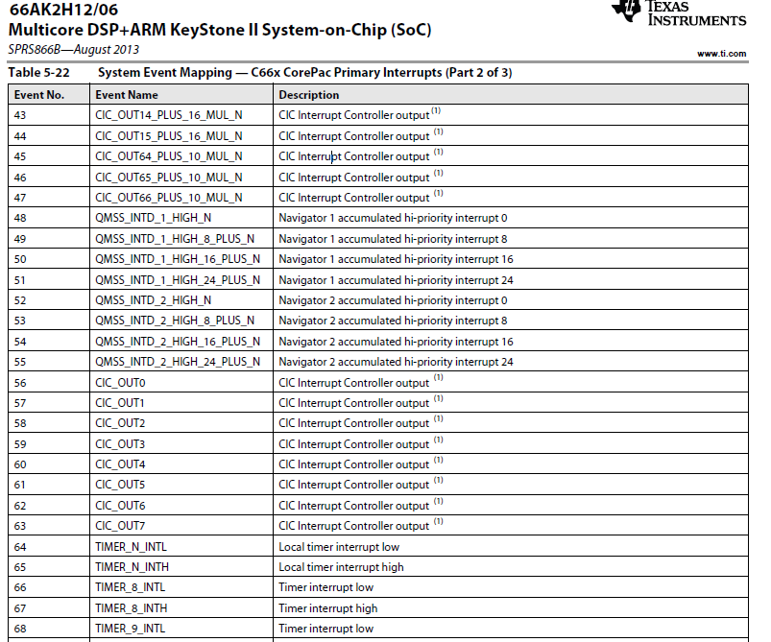

Slide 11
Where is SPIXEVT?
Not on the above page
Not on any of the other two pages in the table
But we see that there are eight events (56 to 63) that come out of the interrupt controller. We can connect SPIXEVT through the interrupt controller to one of these events (broadcast events)
They are other events from the interrupt controller that could be considered (Both, broadcast and single core)
The ARM GIC has 480 input events and 12 of them are connected to SPI

Slide 12
Connecting SPIXEVT to Core 3
66AK2H12 has multiple instances of SPI, we will look at SPI 0
The next slide will show one page from the input table for CIC0. Same events are connected to CIC1 as well

Slide 13
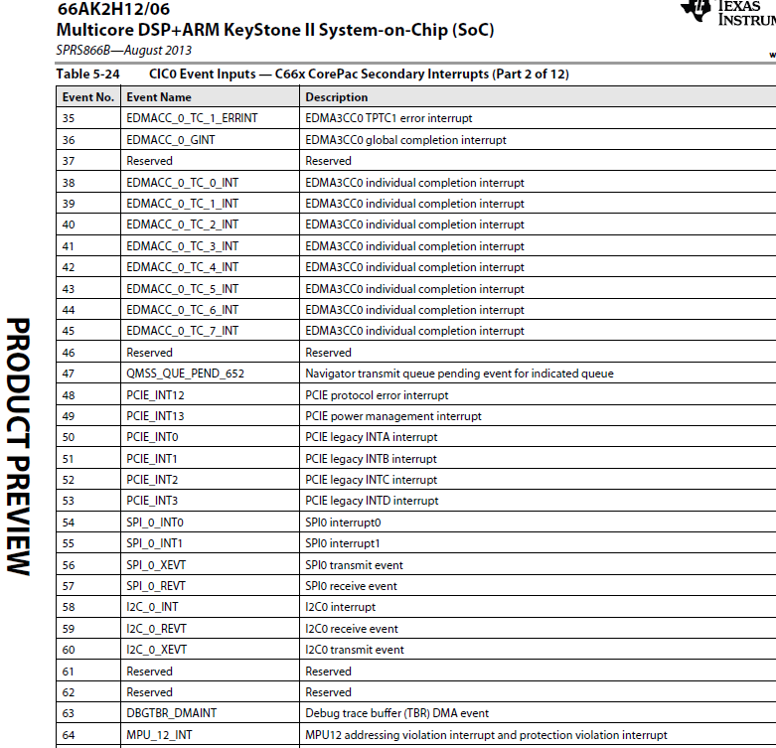

Slide 14
Connecting SPI 0 Transmit event to core 3 ISR

Slide 15
Agenda
Motivation for this presentation
The interrupt Scheme
Configure interrupt

Slide 16
Configuration API
Read the following Wiki: http://processors.wiki.ti.com/index.php/Configuring_Interrupts_on_Keystone_Devices
For KeyStone II (MCSDK 3), look at the two include files csl_cpIntc.h and csl_cpIntCAux.h to see all the API that are needed
The next slide with show APIs to connect system events to channels (output of the CIC) and the channel events to interrupt line

Slide 17
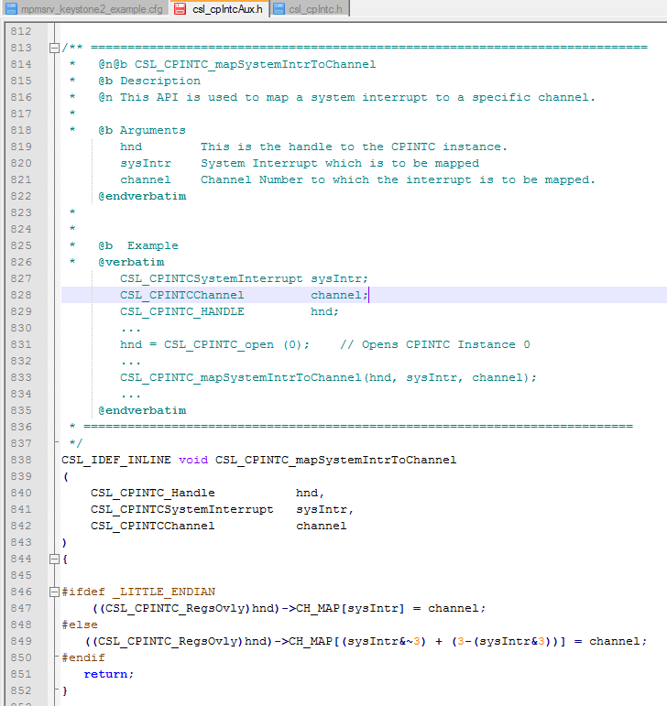

Slide 18
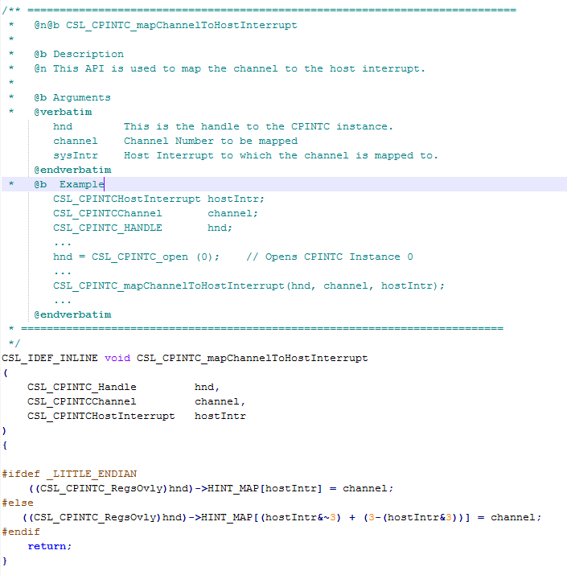

Slide 19
Code examples
Examples in the release MCSDK_3_01_12\pdk_keystone2_3_00_01_12\packages\ti\drv there are examples that use interrupts from peripherals
We will look at HyperLink example
The example – getting an interrupt from Hyperlink 0 to a core

Slide 20
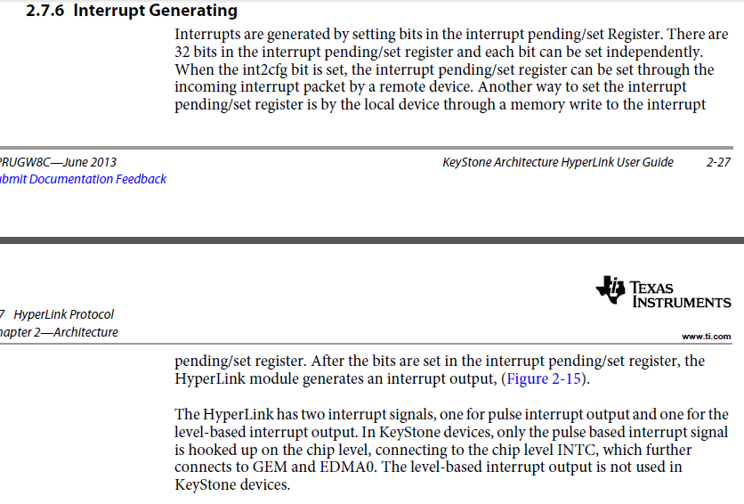
Hyperlink UG

Slide 21
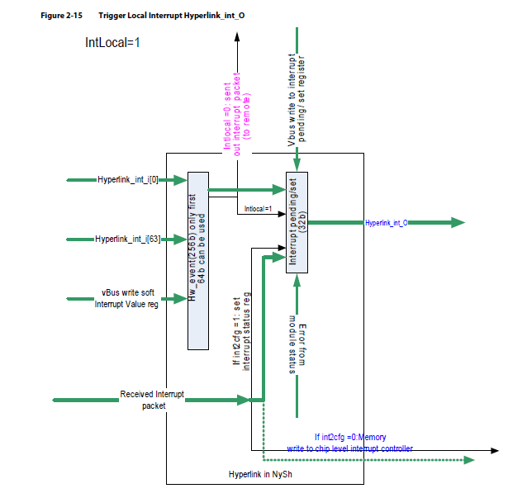

Slide 22
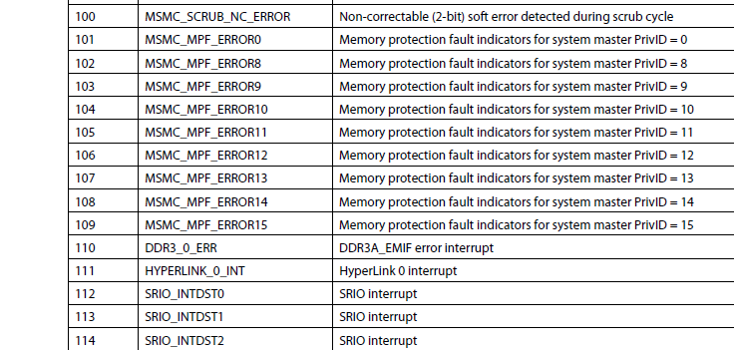
Following Hyperlink Interrupt 0 From table 5-24 of 66AK2H12- CIC0 input events
Event number 111 (ox6F) is HyperLink 0 interrupt
Next we have to connect this to a core

Slide 23
static int hyplnkExampleInitChipIntc (void)
{
CSL_CPINTC_Handle hnd;
// I drop some of the functions here (enable/disable interrupts etc.
CSL_CPINTC_mapSystemIntrToChannel (hnd, CSL_CIC0_HYPERLINK_0_INT, hyplnk_EXAMPLE_INTC_OUTPUT);
// I drop some of the functions here (enable/disable interrupts etc.
return 0;
}
CSL_CIC0_HYPERLINK_0_INT = 111
What about hyplnk_EXAMPLE_INTC_OUTPUT?

Slide 24
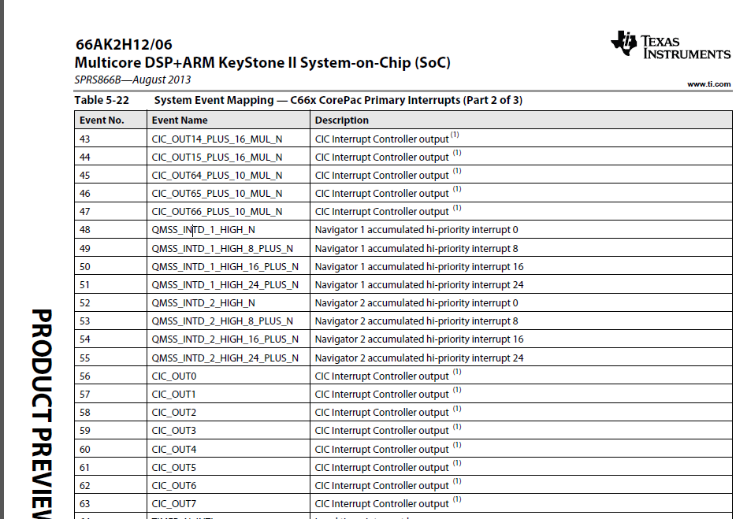
Choose to use event 45 of the core
It could be any one of other CIC_OUT lines (look at the complete table for even more)

Slide 25
Following Hyperlink Interrupt 0 - Continue
Event 45 on the C66 core is connected to CIC out 64 + 10 x N, that is
Core 0 event 45 is connected to CIC output event 64
Core 1 event 45 is connected to CIC output event 74
Core 2 event 45 is connected to CIC output event 84
You got the point
CIC0 should map input event 111 to output event 64 (or 74, or 84 or … depends on what core is used)

Slide 26

Screen Shot of CCS
The value of hyplnk_EXAMPLE_INTC_OUTPUT is (64 + 10 * DNUM)

Slide 27
Questions?

